Slide 1

BIG MARKET SALES PREDICTION
Department of Computer Science &Engineering-Data Science
GUIDED BY: G.SWAPNA
Student: Yamasani Venkata Akhil Teja Reddy

Slide 2

CONTENTS
ABSTRACT
INTRODUCTION
PROBLEM DEFINITION AND SCOPE
FUNCTIONAL REQUIREMENTS
EXISTING SYSTEM
PROPOSED SYSTEM
ADVANTAGES
DISADVANTAGE
SYSTEM ARCHITECTURE
OUTPUT SCREENS
APPLICATIONS
CONCLUSION

Slide 3
ABSTRACT
The aim of the project is to predict the sales of Big Markets. The Big Market sales dataset also consists of certain attributes for each product and store. This model helps Big Market understand the properties of products and stores that play an important role in increasing their overall sales. We perform exploratory data analysis, data pre-processing and feature engineering on the dataset. The required outlets are shown as graphs in different ways and software used is jupyter notebook, libraries like numpy,pandas, seaborn,etc are imported. We compare, correlate and predict the behavior of the outlet columns.

Slide 4
INTRODUCTION
Global malls and stores chains and the increase in the number of electronic payment customers.
Each organization is trying to attract more customers using personalized and short-time offers.
Prediction of future volume of sales of every item an important asset in the planning and inventory management of every organization, transport service, etc.
For analysing patterns and trends of customers purchasing it has become possible to use sophisticated machine learning algorithms for this purpose.
In this project we are providing prediction for the sales data of big market
Analysing the data in a number of various stores across various locations which is based on the outlets being established and their sales.

Slide 5
PROBLEM DEFINITION AND SCOPE
Analysing the data , performing Exploratory Data Analysis and finding patterns and trends inside the data.
Regression is an important machine learning model for these kinds of problems.
Predicting sales of a company needs sales and purchases being happened till date of that company.
Based on that data that fits in the model we can predict the sales of that company or product.
So, in this research project we will analyze the sales, product information, location types, item mrp etc of a company and will predict the sales of the company for a specific product.
For this kind of project of sales predict, we will apply the Random Forest regressor, decision tree, K-Means Clustering and evaluate the result based on the training and validation set of the data.
Using test dataset will predict sales of company data and identify their profits.

Slide 6
FUNCTIONAL REQUIREMENTS
HARDWARE REQUIREMENTS
Ram – 4GB
Hard Disk
Processor
SOFTWARE REQUIREMENTS
Python
Jupyter Notebook
DataLore

Slide 7
EXISTING SYSTEM
Existing system involves visualising single columns.
Previously linear regression and random forest are more often used for predicting target variable.
It uses general visualization libraries.

Slide 8
PROPOSED SYSTEM
We will explore the problem in following stages:
Data Exploration — looking at categorical and continuous feature summaries and making inferences about the data.
Data Cleaning — imputing missing values in the data and checking for outliers.
Feature Engineering — modifying existing variables and creating new ones for analysis.
Model Building — making predictive models on the data.
Prediction — Predicting outlet sales for respective outlet. Predicting the sales for newly entered data without target variable.

Slide 9
ADVANTAGES
Easy representation with help of clustering algorithms.
Can predict the sales for newly entered data.
Easy representation.
Performing exploratory data analysis

Slide 10
DISADVANTAGES
Difficulty in cleaning the noisy data.
Performing not well with certain algorithms.
Difficulty in obtaining good accuracy.

Slide 11
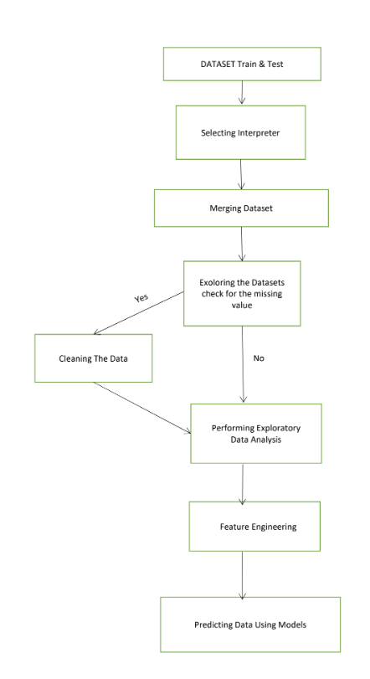
SYSTEM ARCHITECTURE

Slide 12
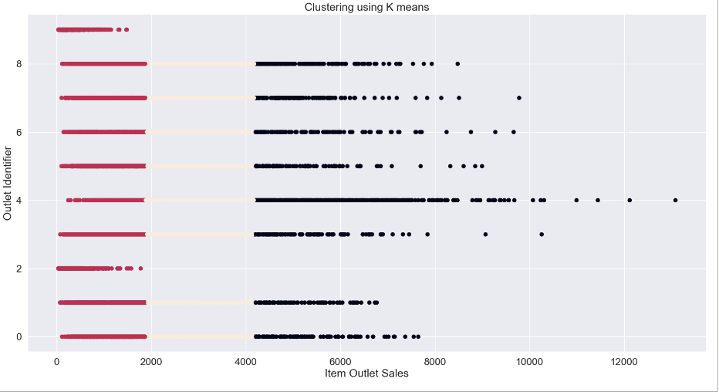
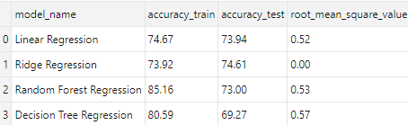
OUTPUT SCREENS

Slide 13
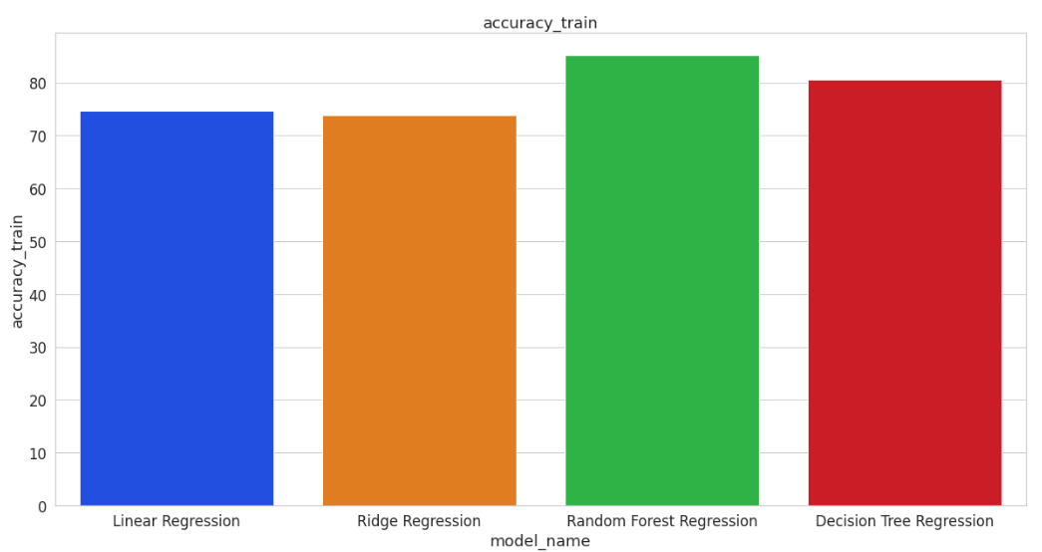
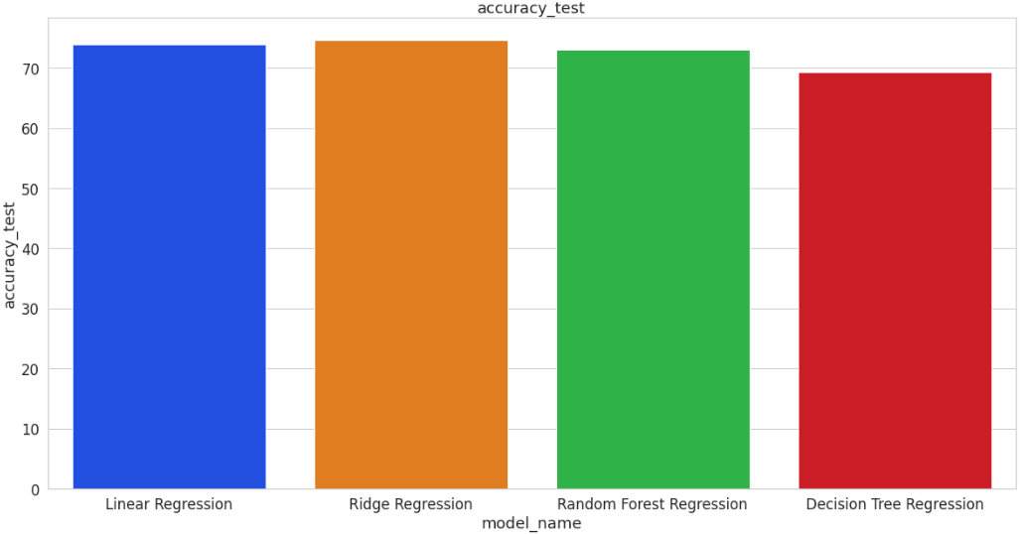
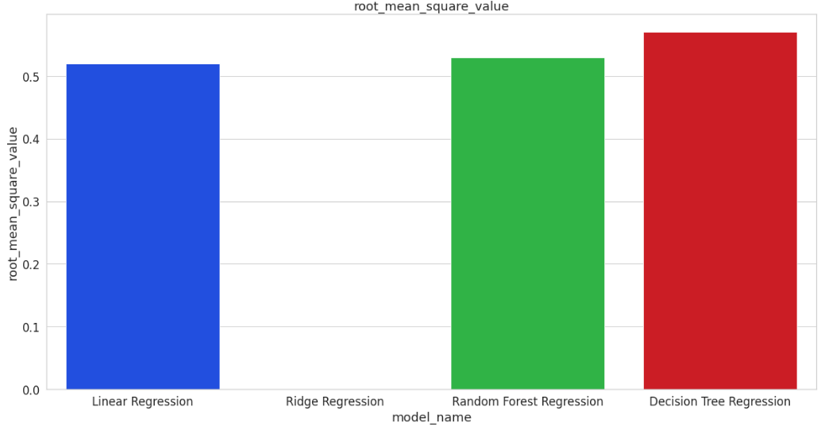

Slide 14
APPLICATIONS
Reliance smart
Dmart
More
Ratnadeep
Vijetha
Polimeras

Slide 15
Conclusion
Most of the shopping malls / shopping centers plan to attract the customers to the store and make profit to the maximum extent by them. Once the customers enter the store then they are attracted then definitely they shop more by the special offers and obtain the desired items which are available in the favorable cost and satisfy them. If the products as per the needs of the customers are provided then it can make maximum profit the retailers can also make the changes in the operations, objectives of the store that cause loss and efficient methods can be applied to gain more profit and sales by observing the history of data the existing stores a clear idea of sales can be known like seasonality trend and randomness.
From the above project, we have predicted the item outlets sales using different algorithms like Decision Tree Regression, K-means clustering, Random Forest Regression and displayed outputs in form of tables, small data frames and various plots of data visualization.

Slide 16


